Slide 1
Modernize SM Dashboard

Slide 2
List of Dashboard Improvements
Addition of new monitors
Add individual monitors for MSEvent_SD and MSEvent_IM.
Ease of Use Changes
Display Dashboard Detail information for current Backlog on Main page.
Historical Reporting
Display Past Backlog and Monitor Information
Make Dashboard more meaningful and helpful.
Make Monitor and other label descriptions more meaningful.
Help - Update Dashboard Help information and attach latest User Guide. Update list of monitors and their thresholds.
Fixes to existing functionality
Update new company logo in header and make company changes in footer.
Contact Us - Fix forms that were not working properly such as feedback form.
Preferences – Fix the instance selection in preferences.
About - Removed outdated information like old contact info.

Slide 3
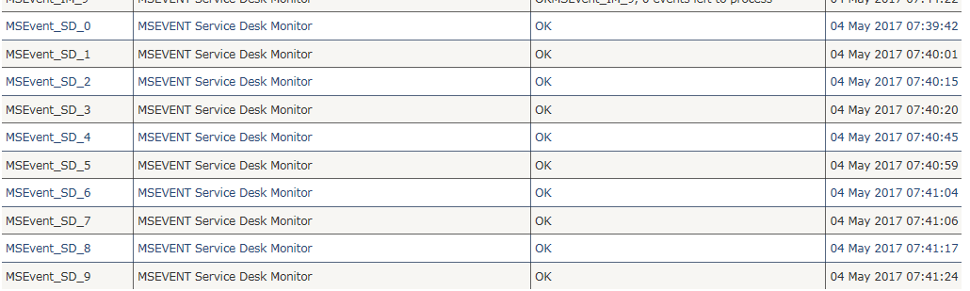
Addition of New Monitors
Monitor changes
Add new MSEvent_SD monitors individually
Benefits/outcome of the changes:
Any backlog on any of these monitor is reported under MSEvent_SD . Now, this will be handle individually and able to find which process is causing the issue and which is more time consuming.

Slide 4
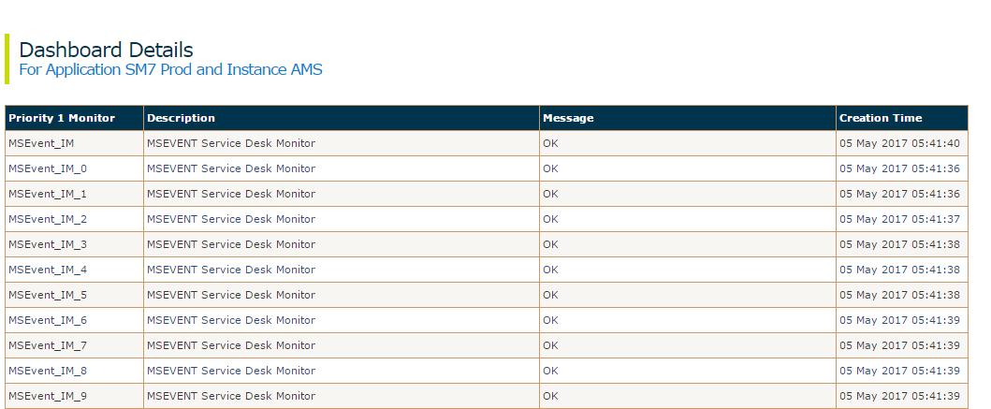
Addition of New Monitors
Monitor changes
Add MSEvent_IM monitors individually
Benefits/outcome of the changes:
Any backlog on any of these monitor is reported under MSEvent_IM . Now, this will be handle individually and able to find which process is causing the issue and which is more time consuming.

Slide 5
Ease of Use Changes
Display Dashboard Detail information for Alerts/Backlog on Main page
Display detail information for current Dashboard alerts/backlog for all applications, instances and monitors on Main Dashboard Page.
Detail alert information to be displayed is Last Scan Date, Status, Instance, Priority, Monitor Name, Backlog in minutes and Records/Events to be processed.
Alerts of all status/thresholds will be displayed on the main page, same as those shown on Dashboard detail page today. Colors for these statuses/thresholds are red for backlog > 30 minutes, yellow for backlog > 20 minutes and White for backlog > 10 minutes.
This detail backlog information will also be updated every 5 minutes when the main page is refreshed.
If users do not want to see the Dashboard Alerts and their details on the Main page, or want to see alerts for only selected applications, they can remove/change it by changing their preferences.
Information for all the monitors for each instance along with any alert/backlog detail information will still be shown on separate Dashboard Detail pages same as today. This page can be used to see all the events, schedules etc. that are being monitored for each application and instance, even those that are not alerting. Also, more descriptive information about these monitors is shown on the Dashboard detail page for each instance.

Slide 6
Ease of Use Changes - Benefits
Display Dashboard Detail information for Alerts/Backlog on Main page
Benefits of the changes:
Users can see a complete view of the status of all the monitor alerts for all applications, instances and priority levels along with detail information like backlog, records processed etc. in one place on the Main Dashboard page.
Currently users have to drill down to each individual application and instance page to check which monitor is alerting, and check backlog etc. For example for SM, users have to drill down to separate detail pages for different regions AMS, EMEA and APJ.
If there are multiple monitors backlogged for an application, instance and priority, they will all be shown on the Main Dashboard page.
Currently, if there are multiple monitors backlogged for an application, instance and priority, only the status of the monitor with the highest threshold is shown. For example, if there are two different monitors backlogged such as Scheduler and Linker, for the same application (e.g. SM), instance (e.g. AMS) and priority (e.g. 1) , one with status ‘red’ for scheduler and the other ‘yellow’ for linker, the current Main Dashboard page will only show the status with ‘red’ color for scheduler, because it has a higher threshold.

Slide 7
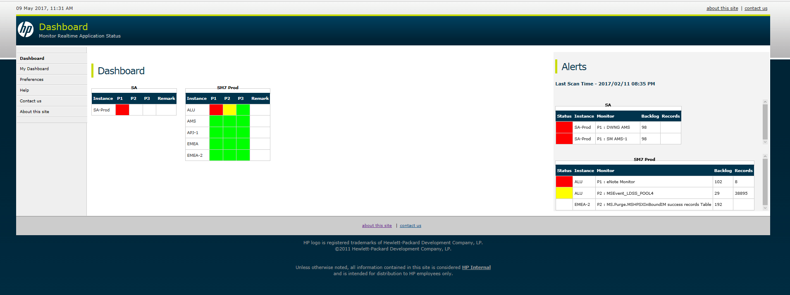
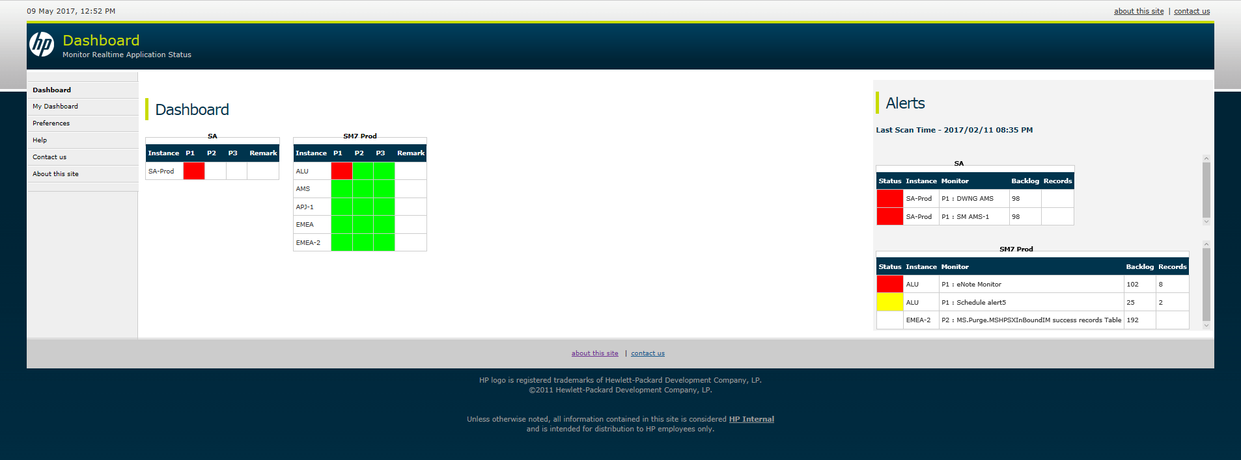
Ease of Use Changes – Screen
Display Dashboard Detail information for Backlog/Alerts on Main page

Slide 8
Historical Reporting – Report Selection Criteria
Access the backlog and monitor information of processes/monitors belonging to a particular region/instance.
How to Access: Click on the "Historical Reporting" link on the left navigation panel.
Criteria for generating the report:
Application – Select one application - SA or SM7 Prod
Instance – Select an instance
For SA : SA-Prod
For SM7 Prod : ALU, AMS, APJ-1, EMEA, EMEA-2
Priority – Select a priority – 1,2 or 3
Calendars: For selecting the reporting period.
Monitors – Filtered based on selected Application, Instance and Priority, and those that have backlog in selected time period.
Report Selection
Report Type - Select Report Type (List of Reports shown on next slide)
Submit Button – Select Submit button to display report.
Export to Excel Button: Visible only after the report is generated.

Slide 9
Historical Reporting – Reports List
Below reports can be displayed based on selected criteria.
Backlog Information
Historical Backlog Detail Information for a monitor.
Shows all the raw backlog information as it was created every 5 minutes.
Historical Backlog Information for a monitor Grouped by Date and Hour.
Useful for bigger time range
Historical Backlog information for a monitor Grouped by Date in crosstab format
Summary with pre-selected monitors in the top row and data grouped by date.
Historical Backlog occurrence Count by Month for all Monitors
Helps to determine which monitors have more frequent backlogs.
Monitor Information
List of monitors and their details for selected application, instance and priority.
Shows list of monitors and their descriptions, priority etc.
List of monitors by region in crosstab format.
Instance/Regions shown in top row with monitor name and its priority under each instance/region.
Note - In first phase, we would like to develop some basic Historical Reporting functionality. In future we may incorporate more Searching/Sorting/Paging/Multi-Select/Formatting/Drill-down features as needed.

Slide 10
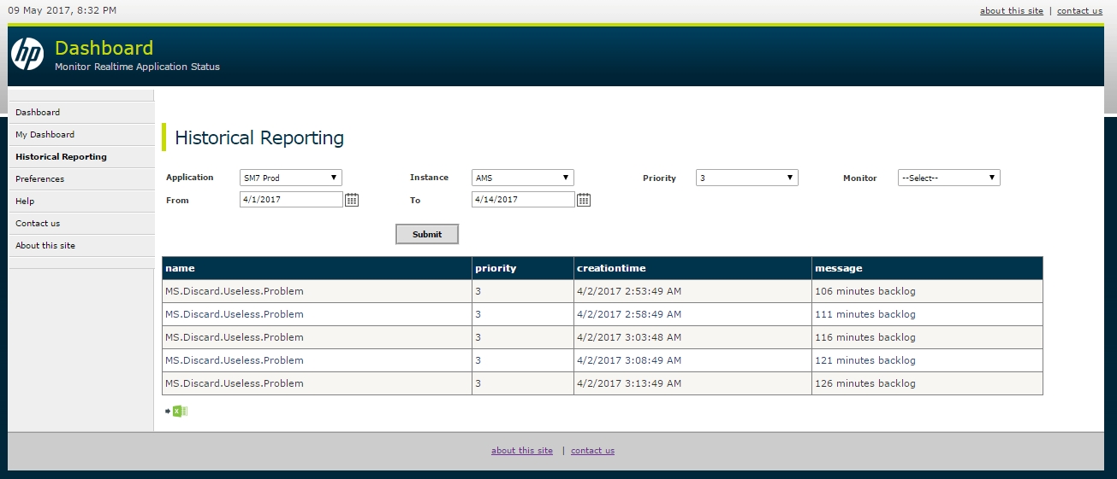
Historical Reporting – Selection Criteria
Example:
On providing the values for which the backlog reports need to be generated, we obtain a tabular column which provides us the name of the processes/monitors which had backlogs between the given dates.

Slide 11
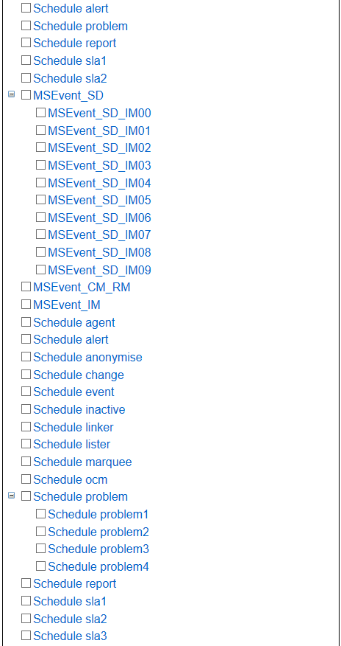
Historical Reporting – Select Monitors
Monitors – Selection of multiple monitors in report criteria could be presented in tree form if desired. This will be a future enhancement. Currently, we will provide selection of only one monitor from pull down list.

Slide 12
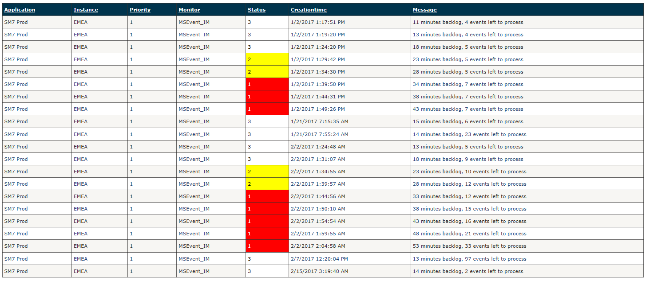
Historical Reporting – Backlog Detail Information per Monitor
Shows all the raw backlog information as it was created every 5 minutes.
Backlog report shows name of selected monitor, Status, Priority, Creation Time and Backlog Message. (Status will be changed to show actual threshold value such as >10, >20 or > 30 min.)

Slide 13
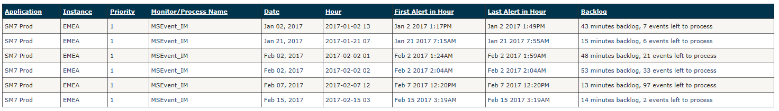
Historical Reporting – Backlog Summary Grouped by Day and Hour per Monitor
For backlog data for multiple days, report can be summarized by date and hour.
This report will show the Date and Hour when backlogs occurred, and also the first and last alert in each hour and the latest backlog information in that hour.

Slide 14
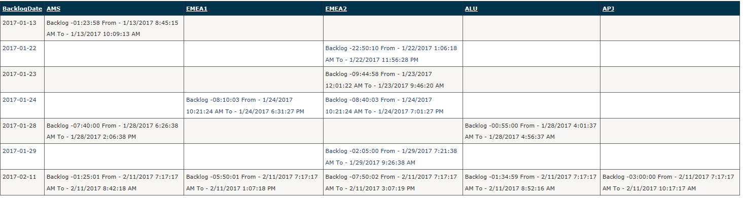
Historical Reporting – Backlog Summary Grouped by Day for selected processes/monitors in crosstab format.
Few Preselected monitors can be shown in cross tab format for easy readability as shown below.
Selected Monitors will be shown on the top header row.
Backlog information will be grouped by date, and the backlog duration and Start and End Time of backlog will be displayed under each monitor
Below example is for Service Agent.

Slide 15
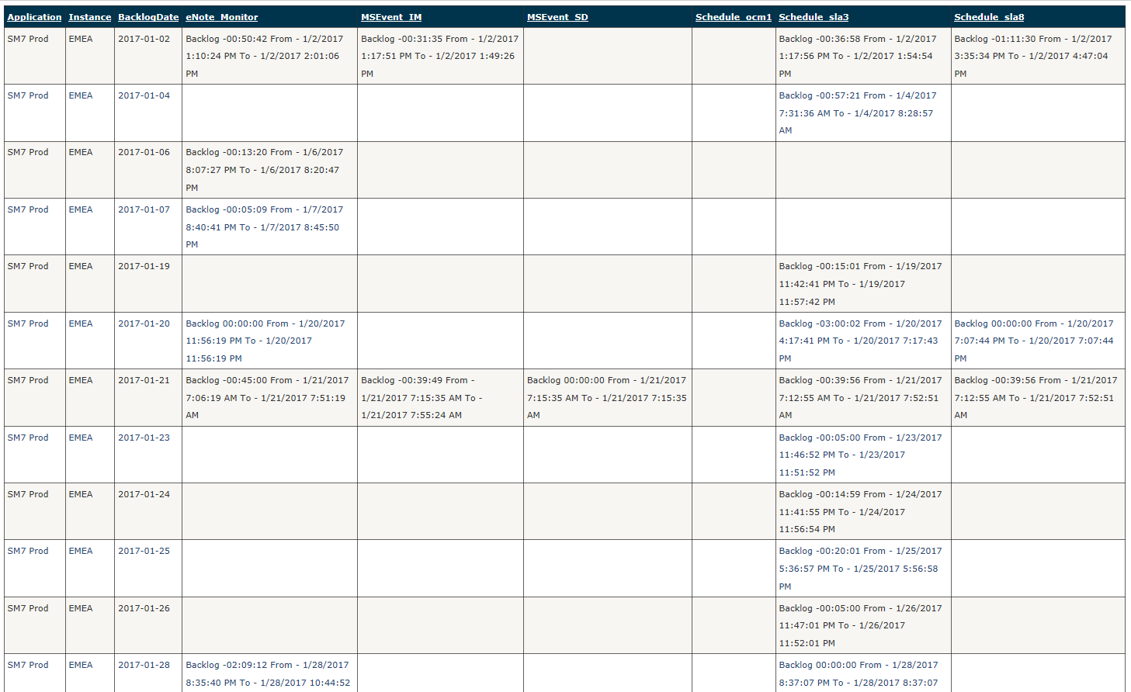
Historical Reporting – Backlog Summary Grouped by Day for selected processes/monitors in crosstab format for SM.

Slide 16
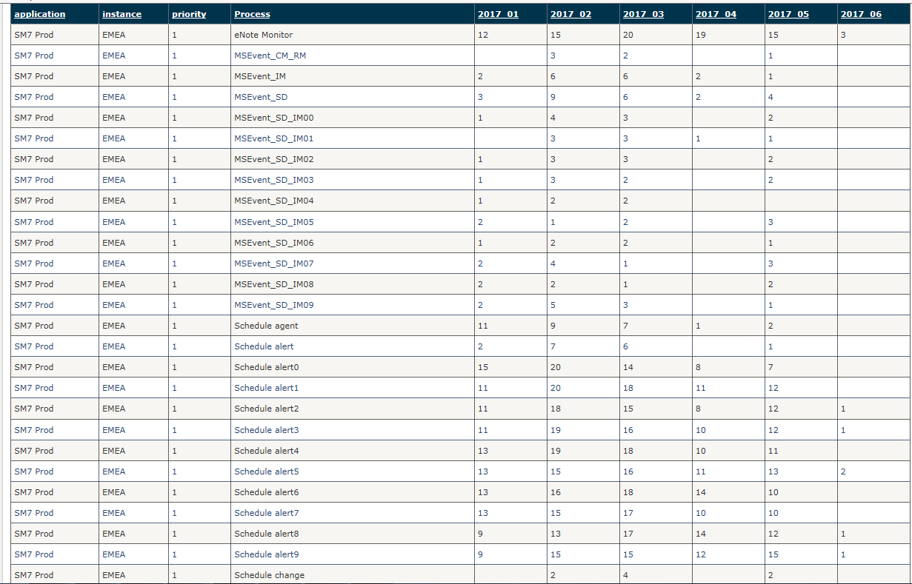
Historical Reporting – Backlog Occurrence Counts by Month for all Monitors.
Shows how many days in a month backlogs occurred for each monitor.
Helps to determine which monitors have more frequent backlogs.

Slide 17
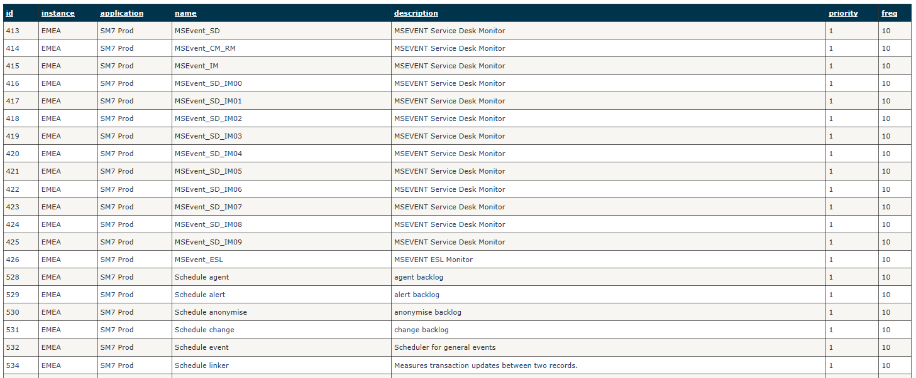
Historical Reporting – List of Monitors and their details
List of Monitors and their details can be displayed.

Slide 18
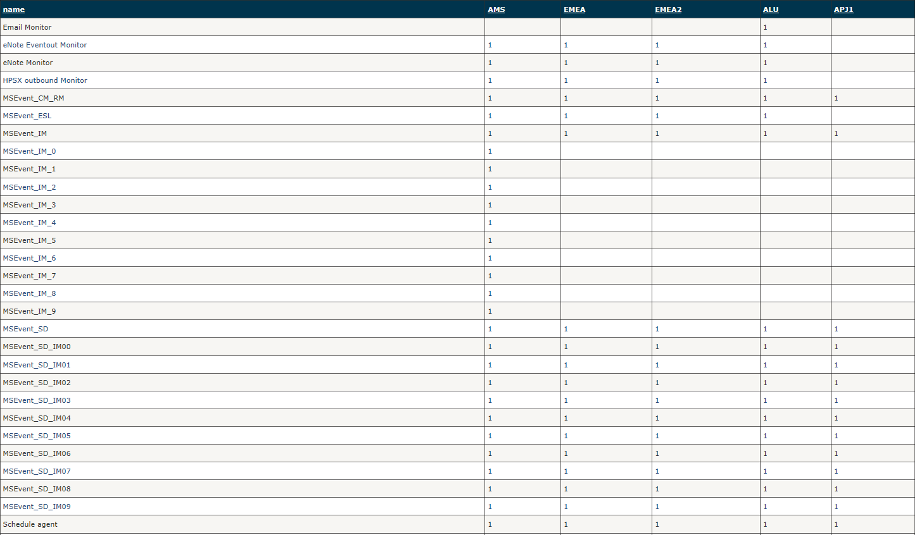
Historical Reporting – List of All SM Monitors by region/instance
List of monitors for SM can also be displayed in crosstab format with each region in the top row, and priority of each monitor under it.

Slide 19
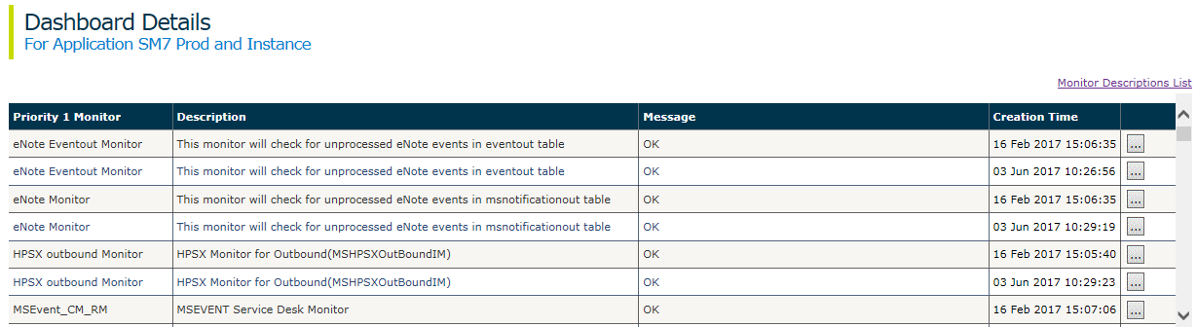
Make Dashboard more meaningful and helpful
Make dashboard monitor/process descriptions more meaningful
The monitor descriptions on Dashboard Detail page will be changed to meaningful text.
If required, detailed descriptions and technical descriptions can be added for these monitors.
A button next to each monitor row, when clicked will open a popup window to show more detailed description and technical description about the selected monitor. (Popup window page shown on next slide).
Also, a link at the top ‘Monitor Descriptions List’ will show detailed descriptions and technical descriptions for all the monitors on one page.

Slide 20
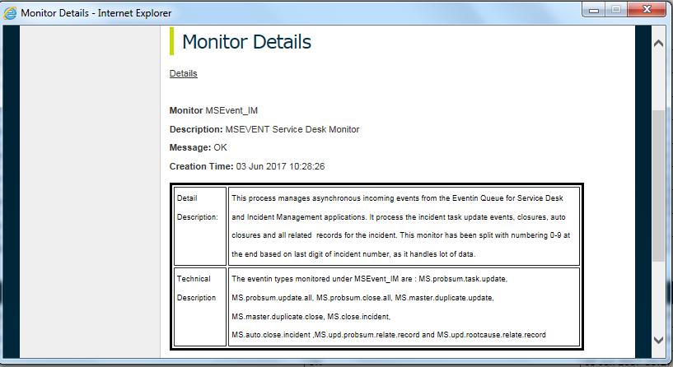
Make Dashboard more meaningful and helpful
Monitor Details for selected monitor
Monitor Detail Description and Technical Description for the selected monitor will be shown in a popup screen.

Slide 21
Make Dashboard more meaningful and helpful
Detailed descriptions and Technical descriptions for all the monitors on one page
Monitors | Detail Description | Technical Description
MSEvent_IM | This process manages asynchronous incoming events from the Eventin Queue for Service Desk and Incident Management applications and also It process the incident task update events, closures, auto closures and all related records for the incident. The monitors is been split 0-9 based on incident number as it handles lot of data and break out based on last digit of incident number | The eventin types which are monitored under MSEvent_IM : MS.probsum.task.update, MS.probsum.update.all, MS.probsum.close.all, MS.master.duplicate.update, MS.master.duplicate.close, MS.close.incident, MS.auto.close.incident ,MS.upd.probsum.relate.record and MS.upd.rootcause.relate.record
MSEvent_IM_0 | This process manages asynchronous incoming events from the Eventin Queue for Service Desk and Incident Management applications and also It process the incident task update events, closures, auto-closures and all related records for the incident records.MSEvent_IM_0 Process the events with incidents that are ending with 0. | The eventin types which are monitored under MSEvent_IM : MS.probsum.task.update, MS.probsum.update.all, MS.probsum.close.all, MS.master.duplicate.update, MS.master.duplicate.close, MS.close.incident, MS.auto.close.incident ,MS.upd.probsum.relate.record and MS.upd.rootcause.relate.record
MSEvent_IM_1 | This process manages asynchronous incoming events from the Eventin Queue for Service Desk and Incident Management applications and also It process the incident task update events, closures,autoclosures and all related records for the incident records. MSEvent_IM_0 Process the events with incidents that are ending with 1. | The eventin types which are monitored under MSEvent_IM : MS.probsum.task.update, MS.probsum.update.all, MS.probsum.close.all, MS.master.duplicate.update, MS.master.duplicate.close, MS.close.incident, MS.auto.close.incident ,MS.upd.probsum.relate.record and MS.upd.rootcause.relate.record
MSEvent_SD | This process manages asynchronous incoming events from the Eventin Queue for Service Desk and Incident Management applications and this process manages the interaction update events and closures .The monitors is been split 0-9 based on interaction as it handles lot of data.
sla | This process monitors service license agreements and processes alerts and Manage SLA status changes like pause and complete status based on incident status.
 | The monitors is been split 0-9 based on ticket number as it handles lot of data and break out based on last digit of ticket number
Linker | This process manages relation between Interaction and incident from related Interaction to closed incidents | Example: when incident record is opened from interaction .Linker process will change the interaction status from open-idle to open-linked
lister | This process manages global variables in the globallist file and builds the globallist by every 60mins. This process keep the dropdowns like Incident activity type, Closure code etc, are updated.
message | This processes manages the Service Manager messages by default, the problem background process manages all Service Manager messages. This process manages IM alerts and messages. Message 1-4 process email and Message process 5-8 popup messages on screen.

Slide 22
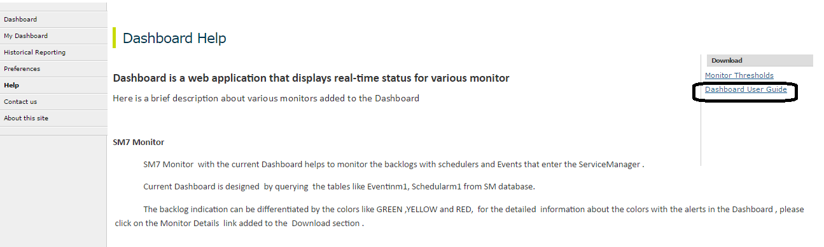
Make Dashboard more meaningful and helpful
Add User guide.
How to Access: Click on “Help” at left pane on dashboard page under “Download” option at right side.
Benefits/outcome of the changes:
Adding Dashboard User guide on the Help page will be useful for the users

Slide 23
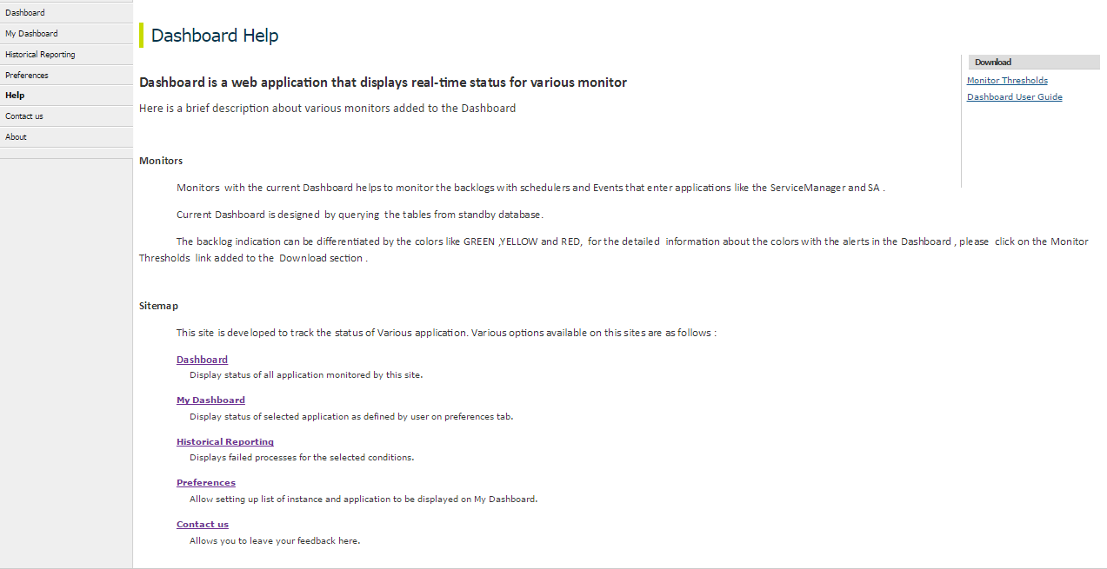
Make Dashboard more meaningful and helpful
Move Sitemap contents to Help link.
How to Access: Click on “Help” at left pane on dashboard page.
Benefits/outcome of the changes:
Move the Contents of Sitemap under Help link label from About This Site to keep all help information at one place

Slide 24
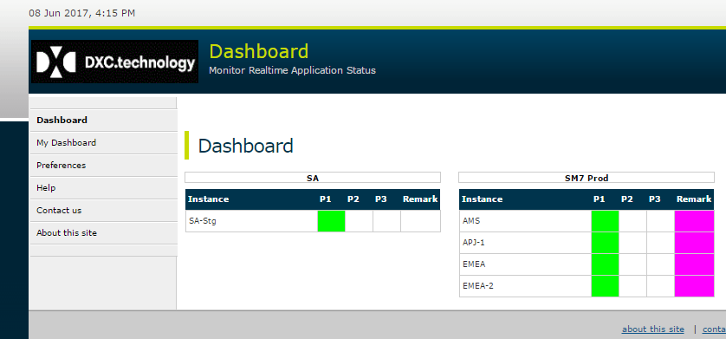
Fixes to existing functionality
LOGO Change:
Change the Logo from HP to DXC.technology

Slide 25
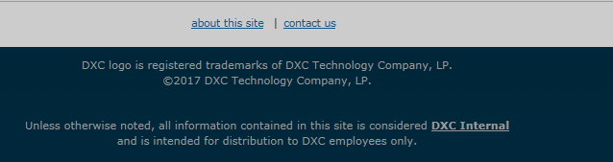
Fixes to existing functionality
Footer change
Change the dashboard footer and the link.

Slide 26
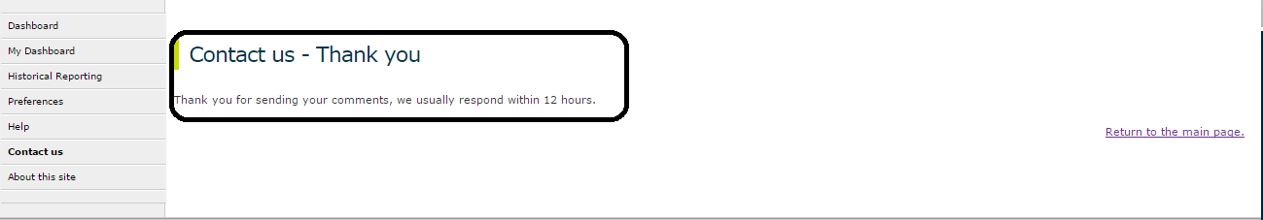
Fixes to existing functionality
Update Contact US page to provide feedback/complaints.
How to Access:Click on “Contact Us” at left pane on dashboard page. Or click on “Contact Us” page in “About this site” page.
Benefits/outcome of the changes:
Previously restriction was allowing only EDS employee to raise feedback/complaint. Now this page should be fixed. so that HPE/DXC user can raise complaint. On submitting complaint, compliant will be sent to Dashboard PDL. And below Successful message will be shown to user. So Dashboard Team can contact user though his/her email ID mentioned while submitting feedback/complaints.

Slide 27
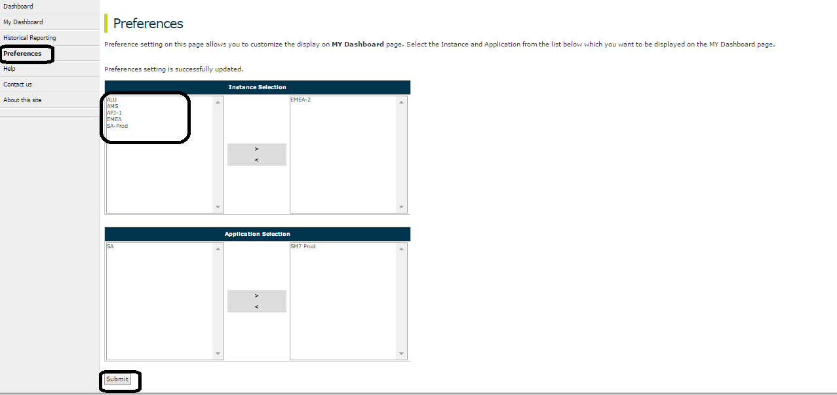
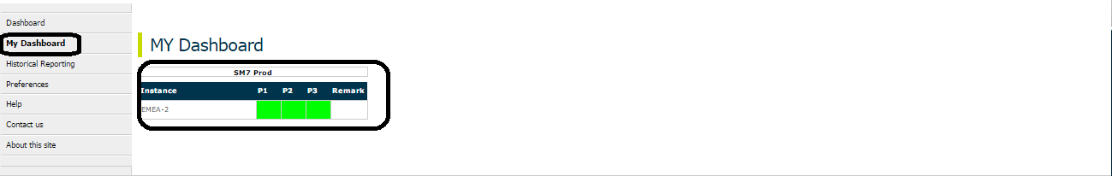
Fixes to existing functionality
Fix “Instance Selection” List issue.
How to Access: Click on “Preferences” at left pane on dashboard page.
Benefits/outcome of the changes:
Currently Instance Selection checkbox are appearing empty and Only values are displayed under “Application Selection” list. fix Instance selection to display all instances available on Dashboard. After selecting requirement Instance and Application combination and clicking on Submit button. User can see their required dashboard instances/applications on “My Dashboard” Page.

Slide 28
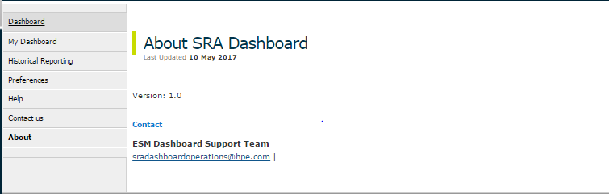
Fixes to existing functionality
Update Contact Detail on “About This Site” page.
How to Access: Click on “About this site” at left pane on dashboard page.
Benefits/outcome of the changes:
Show Dashboard Version and correct Contact detail.

Slide 29
Questions

Slide 30
Thank you

